Slide 1

Big mountain resort
Emine Erdogan

Slide 2
Problem Identification
How can Big Mountain Resort to maximize its annual returns through its pricing strategy starting in October 2023?
The best resort in the state
Current Ticket Price for Weekdays & Weekend ➔ $81/per person/day
Annual skiers and riders, each staying for 5 days ➔ Around 350.000 visitors
Additional chair lift’s operating costs ➔ $1,540,000 (installed recently)

Slide 3
Key Findings
Based on the model we developed (Random Forest Model), using the data from nationwide ski resort data,
The recommended ticket price is $95.87 ± $10.39
Potential increase in annual revenue by ~$25 million

Slide 4
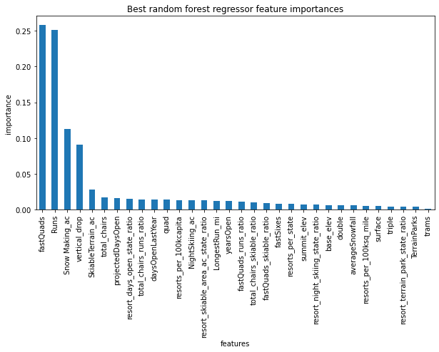
Modeling Results and Analysis
Features that came up as the most important in the modeling:
Number of fast quads,
Number of runs
Area covered by snow-making machines
Length of vertical drop

Slide 5
Modeling Results and Analysis
Scenarios for
Cutting costs :
Closing the 5 runs can be considered as an option to reduce the expenses, the ticket prices decrease between $1.50-$2.00.
Increasing revenue:
Adding a new run, increasing the vertical drop by 150 feet, and installing an additional chair lift can increase ticket price by $1.99.

Slide 6
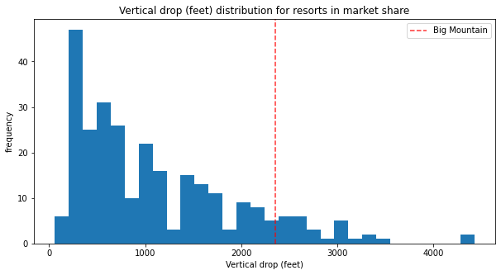
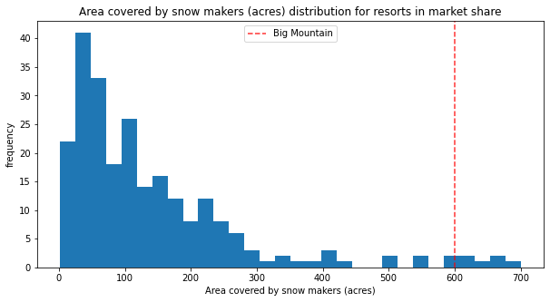
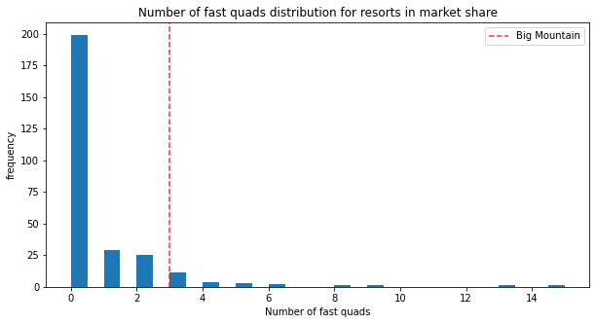
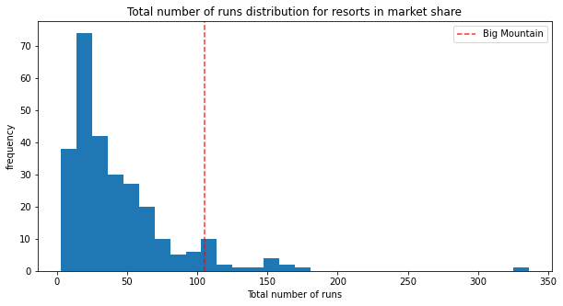
Modeling Results and Analysis

Slide 7
Summary and Conclusion
Big Mountain Ski Resort is one of the best ski resorts in USA.
It has great facilities and futures for their visitors.
Great opportunities for Big Mountain to increase their profitability are available.
Increasing their prices from $81 to around $95
Feature modifications

